Slide 1
Frequency Distributions
Chad Williams
University of Victoria

Slide 2
Lecture Outline
Frequency Distributions
Stem and Leaf Display
Tables
Figures

Slide 3
Decimal Rules
If we do any math more complex than addition or subtraction
e.g., multiplication, squaring
Computations should include 4 decimals
Report to 2 decimals
Exception: Report p-values to as many decimals as our tables provide us (Unit 3.1.)
If we do not do any math more complex than addition or subtraction
Report the number of decimals as given
Whole numbers stay whole numbers (30 -> 30)
Numbers with decimals keep those decimals (30.56 -> 30.56)

Slide 4
Lecture Outline
Frequency Distributions
Stem and Leaf Display
Tables and Figures

Slide 5
Purpose of Data Summaries
Bring order out of chaos
Observe trends
Assist analyses
Communicate!

Slide 6
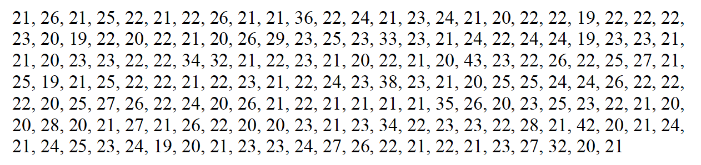
Importance of Visualization
Statistical Summaries: Simplifying data into interpretable metrics
Raw data is overwhelming and difficult to interpret
We can summarize the data below into things like averages, max and min, etc.
Average = 23.30
Min = 19, Max = 43

Slide 7
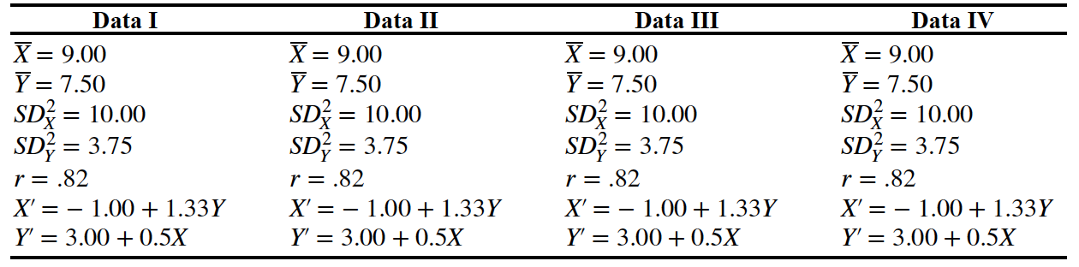
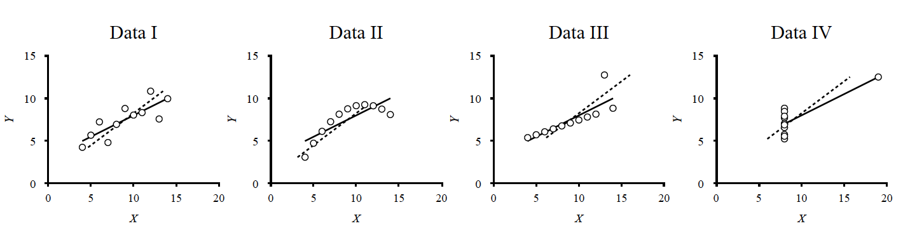
Importance of Visualization
Statistical Summaries: Simplifying data into interpretable metrics
BUT summaries can be too simple as well

Slide 8
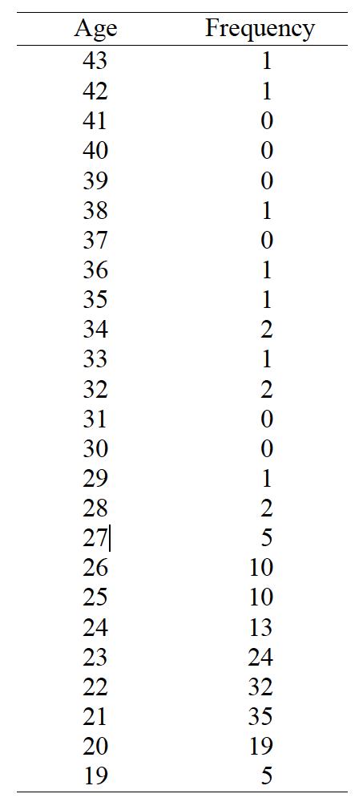
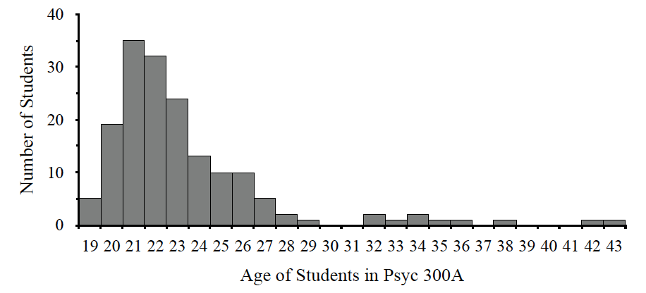
Frequency Distribution
Visualization: The method of showing data graphically

Slide 9
Frequency Distribution

Slide 10
Creating a Frequency Distribution
20, 25, 18, 19, 20, 19, 21, 19, 19, 20

Slide 11
Creating a Frequency Distribution
20, 25, 18, 19, 20, 19, 21, 19, 19, 20
Step 1: Determine how many participants you have
Step 2: Sort data (lowest to highest)
Step 3: Count the frequency for each unique number
Step 4: Determine the relative frequency of each number
Step 5: Determine the cumulative frequency
Step 6: Determine the cumulative relative frequency

Slide 12
Creating a Frequency Distribution
20, 25, 18, 19, 20, 19, 21, 19, 19, 20
Step 1: Determine how many participants you have
Depicted as N (sample size)
N = 10

Slide 13
Creating a Frequency Distribution
20, 25, 18, 19, 20, 19, 21, 19, 19, 20
Step 2: Sort data (lowest to highest)
18, 19, 19, 19, 19, 20, 20, 20, 21, 25 OR:
18
19, 19, 19, 19
20, 20, 20
21
25
Immediately helpful (e.g., lowest and highest age)

Slide 14
Creating a Frequency Distribution
Age | Freq.
25 | 1
24 | 0
23 | 0
22 | 0
21 | 1
20 | 3
19 | 4
18 | 1
20, 25, 18, 19, 20, 19, 21, 19, 19, 20
Step 3: Count the frequency for each unique number
Frequency: Number of samples in a category
18 -> 1
19, 19, 19, 19 -> 4
20, 20, 20 -> 3
21 -> 1
25 -> 1
Note: even those with 0 frequency are included

Slide 15
Creating a Frequency Distribution
Age | Freq. | Rel. Freq.
25 | 1
24 | 0
23 | 0
22 | 0
21 | 1
20 | 3 | 0.30
19 | 4
18 | 1
20, 25, 18, 19, 20, 19, 21, 19, 19, 20
Step 4: Determine the relative frequency of each number
Relative Frequency: Proportion of samples in a category
Rel. Freq. = frequency / N
E.g., for the frequency of age 20:
3/10 = 0.30

Slide 16
Creating a Frequency Distribution
Age | Freq. | Rel. Freq.
25 | 1 | 0.10
24 | 0 | 0.00
23 | 0 | 0.00
22 | 0 | 0.00
21 | 1 | 0.10
20 | 3 | 0.30
19 | 4 | 0.40
18 | 1 | 0.10
20, 25, 18, 19, 20, 19, 21, 19, 19, 20
Step 4: Determine the relative frequency of each number
Relative Frequency: Proportion of samples in a category
Rel. Freq. = frequency / N
E.g., for the frequency of age 20:
3/10 = 0.30

Slide 17
Creating a Frequency Distribution
Age | Freq. | Rel. Freq.
25 | 1 | 0.10
24 | 0 | 0.00
23 | 0 | 0.00
22 | 0 | 0.00
21 | 1 | 0.10
20 | 3 | 0.30
19 | 4 | 0.40
18 | 1 | 0.10
20, 25, 18, 19, 20, 19, 21, 19, 19, 20
Step 4: Determine the relative frequency of each number
Note that relative frequencies are proportions
We’ll be using proportions a lot in this course

Slide 18
Creating a Frequency Distribution
Age | Freq. | Rel. Freq.
25 | 1 | 0.10
24 | 0 | 0.00
23 | 0 | 0.00
22 | 0 | 0.00
21 | 1 | 0.10
20 | 3 | 0.30
19 | 4 | 0.40
18 | 1 | 0.10
20, 25, 18, 19, 20, 19, 21, 19, 19, 20
Step 4: Determine the relative frequency of each number
Proportions are percentages divided by 100
Proportions range from 0 to 1
0.10 proportion = 10%
Percentages are proportions times 100
Percentages range from 0 to 100
40% = 0.40 proportion

Slide 19
Creating a Frequency Distribution
20, 25, 18, 19, 20, 19, 21, 19, 19, 20
Step 4: Determine the relative frequency of each number
Proportions are percentages divided by 100
Proportions range from 0 to 1
0.10 proportion = 10%
Percentages are proportions times 100
Percentages range from 0 to 100
40% = 0.40 proportion
75%
0.75

Slide 20
Creating a Frequency Distribution
Age | Freq. | Rel. Freq. | Cum. Freq.
25 | 1 | 0.10
24 | 0 | 0.00
23 | 0 | 0.00
22 | 0 | 0.00
21 | 1 | 0.10
20 | 3 | 0.30
19 | 4 | 0.40
18 | 1 | 0.10 | 1
20, 25, 18, 19, 20, 19, 21, 19, 19, 20
Step 5: Determine the cumulative frequency
Cumulative frequency: Number of samples in this category and in all categories below this one
Goes from bottom to top:
18 has 1 person

Slide 21
Creating a Frequency Distribution
Age | Freq. | Rel. Freq. | Cum. Freq.
25 | 1 | 0.10
24 | 0 | 0.00
23 | 0 | 0.00
22 | 0 | 0.00
21 | 1 | 0.10
20 | 3 | 0.30
19 | 4 | 0.40 | 5
18 | 1 | 0.10 | 1
20, 25, 18, 19, 20, 19, 21, 19, 19, 20
Step 5: Determine the cumulative frequency
Cumulative frequency: Number of samples in this category and in all categories below this one
Goes from bottom to top:
19 has 4 people and 18 has 1 person

Slide 22
Creating a Frequency Distribution
Age | Freq. | Rel. Freq. | Cum. Freq.
25 | 1 | 0.10 | 10
24 | 0 | 0.00 | 9
23 | 0 | 0.00 | 9
22 | 0 | 0.00 | 9
21 | 1 | 0.10 | 9
20 | 3 | 0.30 | 8
19 | 4 | 0.40 | 5
18 | 1 | 0.10 | 1
20, 25, 18, 19, 20, 19, 21, 19, 19, 20
Step 5: Determine the cumulative frequency
Cumulative frequency: Number of samples in this category and in all categories below this one
Goes from bottom to top:
19 has 4 people and 18 has 1 person

Slide 23
Creating a Frequency Distribution
Age | Freq. | Rel. Freq. | Cum. Freq. | Cum. Rel. Freq.
25 | 1 | 0.10 | 10
24 | 0 | 0.00 | 9
23 | 0 | 0.00 | 9
22 | 0 | 0.00 | 9
21 | 1 | 0.10 | 9
20 | 3 | 0.30 | 8
19 | 4 | 0.40 | 5
18 | 1 | 0.10 | 1 | 0.10
20, 25, 18, 19, 20, 19, 21, 19, 19, 20
Step 6: Determine the cumulative relative frequency
Cumulative relative frequency: Proportion of samples in this category and in all categories below this one
Goes from bottom to top:
18 has 0.10

Slide 24
Creating a Frequency Distribution
Age | Freq. | Rel. Freq. | Cum. Freq. | Cum. Rel. Freq.
25 | 1 | 0.10 | 10
24 | 0 | 0.00 | 9
23 | 0 | 0.00 | 9
22 | 0 | 0.00 | 9
21 | 1 | 0.10 | 9
20 | 3 | 0.30 | 8
19 | 4 | 0.40 | 5 | 0.50
18 | 1 | 0.10 | 1 | 0.10
20, 25, 18, 19, 20, 19, 21, 19, 19, 20
Step 6: Determine the cumulative relative frequency
Cumulative relative frequency: Proportion of samples in this category and in all categories below this one
Goes from bottom to top:
19 has 0.40 and 18 has 0.10

Slide 25
Creating a Frequency Distribution
Age | Freq. | Rel. Freq. | Cum. Freq. | Cum. Rel. Freq.
25 | 1 | 0.10 | 10 | 1.00
24 | 0 | 0.00 | 9 | 0.90
23 | 0 | 0.00 | 9 | 0.90
22 | 0 | 0.00 | 9 | 0.90
21 | 1 | 0.10 | 9 | 0.90
20 | 3 | 0.30 | 8 | 0.80
19 | 4 | 0.40 | 5 | 0.50
18 | 1 | 0.10 | 1 | 0.10
20, 25, 18, 19, 20, 19, 21, 19, 19, 20
Step 6: Determine the cumulative relative frequency
Cumulative relative frequency: Proportion of samples in this category and in all categories below this one
Goes from bottom to top:
19 has 0.40 and 18 has 0.10

Slide 26
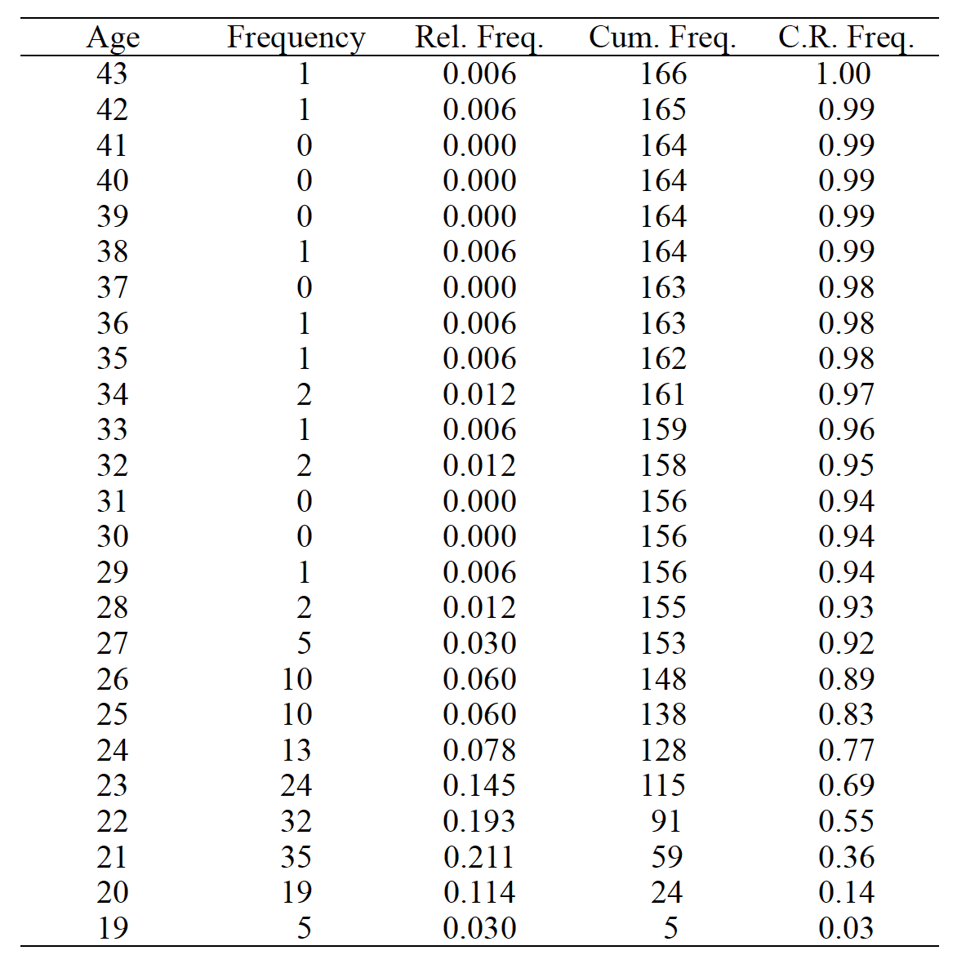
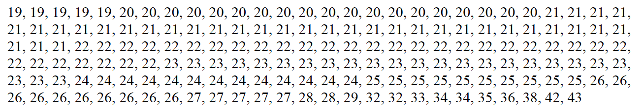
Creating a Frequency Distribution

Slide 27
Creating a Frequency Distribution
Age | Freq. | Rel. Freq. | Cum. Freq. | Cum. Rel. Freq.
25 | 1 | 0.10 | 10 | 1.00
24 | 0 | 0.00 | 9 | 0.90
23 | 0 | 0.00 | 9 | 0.90
22 | 0 | 0.00 | 9 | 0.90
21 | 1 | 0.10 | 9 | 0.90
20 | 3 | 0.30 | 8 | 0.80
19 | 4 | 0.40 | 5 | 0.50
18 | 1 | 0.10 | 1 | 0.10
20, 25, 18, 19, 20, 19, 21, 19, 19, 20
Now, this summarizes data well while still providing lots of information
Minimum + Maximum age
The most common age
That one student is (slightly) older than the rest

Slide 28
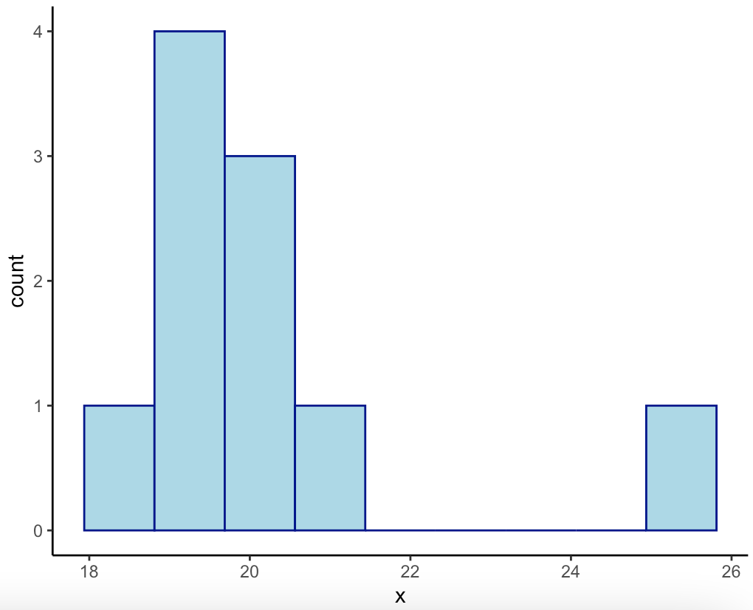
Creating a Frequency Distribution
Age | Freq. | Rel. Freq. | Cum. Freq. | Cum. Rel. Freq.
25 | 1 | 0.10 | 10 | 1.00
24 | 0 | 0.00 | 9 | 0.90
23 | 0 | 0.00 | 9 | 0.90
22 | 0 | 0.00 | 9 | 0.90
21 | 1 | 0.10 | 9 | 0.90
20 | 3 | 0.30 | 8 | 0.80
19 | 4 | 0.40 | 5 | 0.50
18 | 1 | 0.10 | 1 | 0.10
20, 25, 18, 19, 20, 19, 21, 19, 19, 20

Slide 29
Creating a Frequency Distribution
Age | Freq. | Rel. Freq. | Cum. Freq. | Cum. Rel. Freq.
25 | 1 | 0.10 | 10 | 1.00
24 | 0 | 0.00 | 9 | 0.90
23 | 0 | 0.00 | 9 | 0.90
22 | 0 | 0.00 | 9 | 0.90
21 | 1 | 0.10 | 9 | 0.90
20 | 3 | 0.30 | 8 | 0.80
19 | 4 | 0.40 | 5 | 0.50
18 | 1 | 0.10 | 1 | 0.10
20, 25, 18, 19, 20, 19, 21, 19, 19, 20
Grouped Intervals: We can combine multiple categories of the variable
For example, age can be
0-4
5-9
10-14
15-19
Etc…

Slide 30
Creating a Frequency Distribution
20, 25, 18, 19, 20, 19, 21, 19, 19, 20
Age | Freq. | Rel. Freq. | Cum. Freq. | Cum. Rel. Freq.
24-25 | 1 | 0.10 | 10 | 1.00
22-23 | 0 | 0.00 | 9 | 0.90
20-21 | 4 | 0.40 | 9 | 0.90
18-19 | 5 | 0.50 | 5 | 0.50
Grouped Intervals
For a grouped interval frequency distribution, follow the same 6 steps but by combining the numbers that fall in the same group

Slide 31
Creating a Frequency Distribution
20, 25, 18, 19, 20, 19, 21, 19, 19, 20
Age | Freq. | Rel. Freq. | Cum. Freq. | Cum. Rel. Freq.
24-25 | 1 | 0.10 | 10 | 1.00
22-23 | 0 | 0.00 | 9 | 0.90
20-21 | 4 | 0.40 | 9 | 0.90
18-19 | 5 | 0.50 | 5 | 0.50
Grouped Intervals
Interval width: The size of the range that we will use to combine values
Width of 10: 0-9, 10-19, 20-29
Width of 5: 0-4, 5-9, 10-14
Width of 2: 0-1, 2-3, 4-5
We choose this number

Slide 32
Creating a Frequency Distribution
20, 25, 18, 19, 20, 19, 21, 19, 19, 20
Age | Freq. | Rel. Freq. | Cum. Freq. | Cum. Rel. Freq.
24-25 | 1 | 0.10 | 10 | 1.00
22-23 | 0 | 0.00 | 9 | 0.90
20-21 | 4 | 0.40 | 9 | 0.90
18-19 | 5 | 0.50 | 5 | 0.50
Grouped Intervals
Intervals are equal in width
First value of each interval is a multiple of the interval width
E.g., if our interval width were 5 here, our first category would be 15-19
Lowest interval contains lowest datum
Highest interval contains highest datum

Slide 33
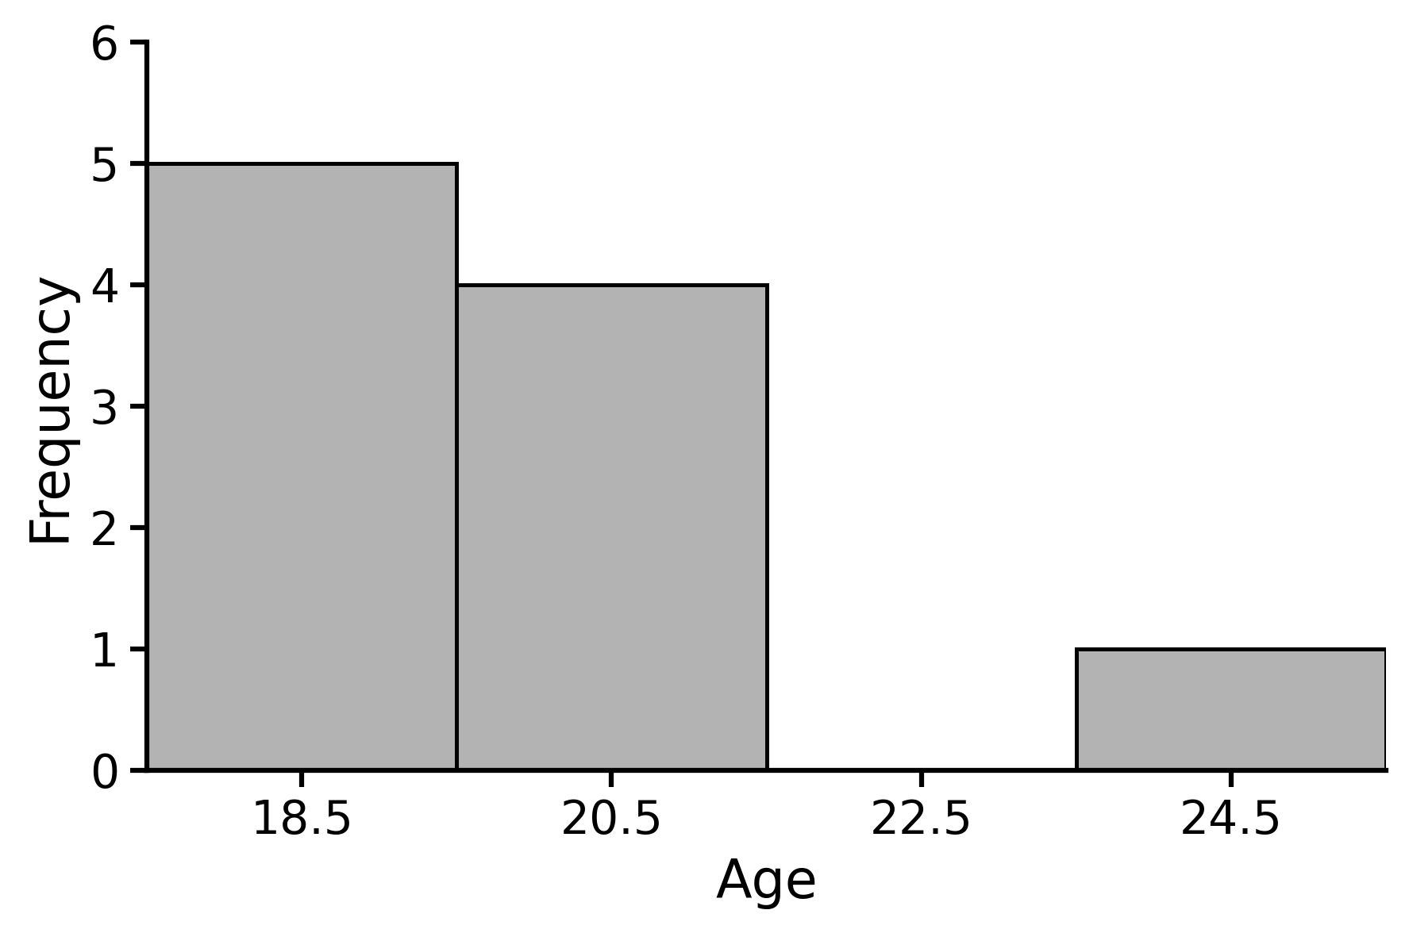
Creating a Frequency Distribution
Grouped Intervals
Age | Freq. | Rel. Freq. | Cum. Freq. | Cum. Rel. Freq.
24-25 | 1 | 0.10 | 10 | 1.00
22-23 | 0 | 0.00 | 9 | 0.90
20-21 | 4 | 0.40 | 9 | 0.90
18-19 | 5 | 0.50 | 5 | 0.50
When grouped intervals are on a plot, we use the midpoint of each interval
Midpoint: (24+25)/2 = 24.5000 = 24.50

Slide 34
Lecture Outline
Frequency Distributions
Stem and Leaf Display
Tables and Figures

Slide 35
Stem and Leaf Display
12, 15, 16, 21, 22, 22, 24, 29, 30, 33, 33, 40, 60
Stem | Leaf
1
2
3
4
5
6
Stem
(leading digit)
Leaf
(trailing digit)
12

Slide 36
Stem and Leaf Display
12, 15, 16, 21, 22, 22, 24, 29, 30, 33, 33, 40, 60
Stem | Leaf
1 | 2
2
3
4
5
6
Stem
(leading digit)
Leaf
(trailing digit)
12

Slide 37
Stem and Leaf Display
12, 15, 16, 21, 22, 22, 24, 29, 30, 33, 33, 40, 60
Stem | Leaf
1 | 2
2
3
4
5
6
Stem
Leaf
12

Slide 38
Stem and Leaf Display
12, 15, 16, 21, 22, 22, 24, 29, 30, 33, 33, 40, 60
Stem | Leaf
1 | 2
2
3
4
5
6
Stem
Leaf
15

Slide 39
Stem and Leaf Display
12, 15, 16, 21, 22, 22, 24, 29, 30, 33, 33, 40, 60
Stem | Leaf
1 | 25
2
3
4
5
6
Stem
Leaf
15

Slide 40
Stem and Leaf Display
12, 15, 16, 21, 22, 22, 24, 29, 30, 33, 33, 40, 60
Stem | Leaf
1 | 256
2
3
4
5
6
Stem
Leaf
21

Slide 41
Stem and Leaf Display
12, 15, 16, 21, 22, 22, 24, 29, 30, 33, 33, 40, 60
Stem | Leaf
1 | 256
2 | 1
3
4
5
6
Stem
Leaf
21

Slide 42
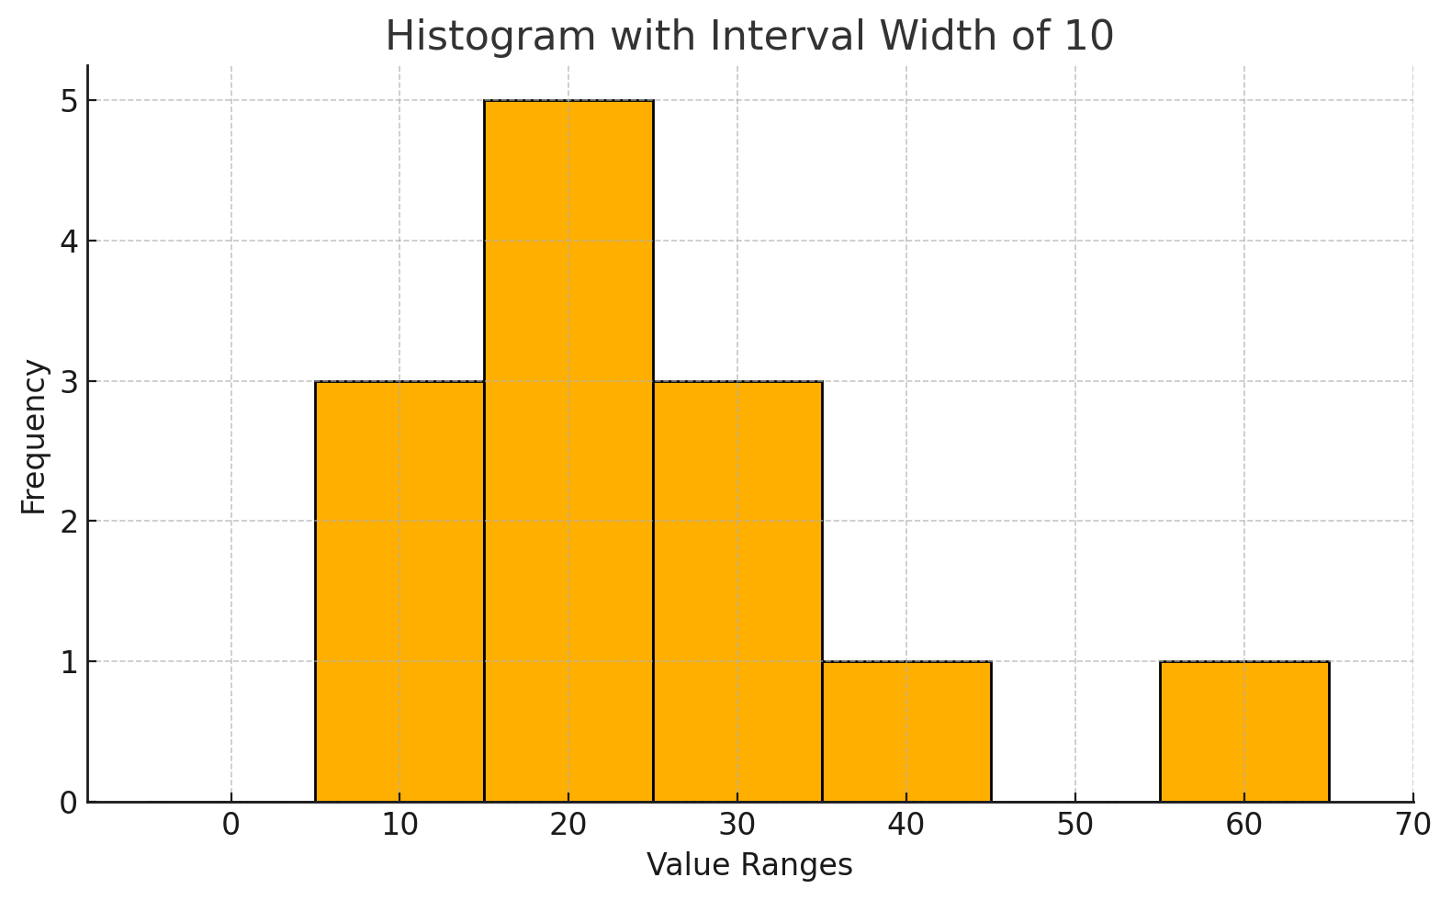
Stem and Leaf Display
12, 15, 16, 21, 22, 22, 24, 29, 30, 33, 33, 40, 60
Stem | Leaf
1 | 256
2 | 12249
3 | 033
4 | 0
5
6 | 0

Slide 43
Stem and Leaf Display
12, 15, 16, 21, 22, 22, 24, 29, 30, 33, 33, 40, 60
Stem | Leaf
1 | 256
2 | 12249
3 | 033
4 | 0
5
6 | 0
Advantages
Presents all data while still summarizing/ visualizing
Conserves individual scores
Disadvantages
Difficult to display with too much data
Can only show intervals of 2, 5, or 10

Slide 44
Stem and Leaf Display
Stem | Leaf
1⁽⁰⁾ | 2
1⁽⁵⁾ | 56
2⁽⁰⁾ | 1224
2⁽⁵⁾ | 9
3⁽⁰⁾ | 033
3⁽⁵⁾
4⁽⁰⁾ | 0
4⁽⁵⁾
…
12, 15, 16, 21, 22, 22, 24, 29, 30, 33, 33, 40, 60
Disadvantages
Can only show intervals of 2, 5, or 10
We break it up like this when digit displays are becoming too long
1⁽⁰⁾ = 10-14
1⁽⁵⁾ = 15-19
2⁽⁰⁾ = 20-24

Slide 45
Lecture Outline
Frequency Distributions
Stem and Leaf Display
Tables and Figures

Slide 46
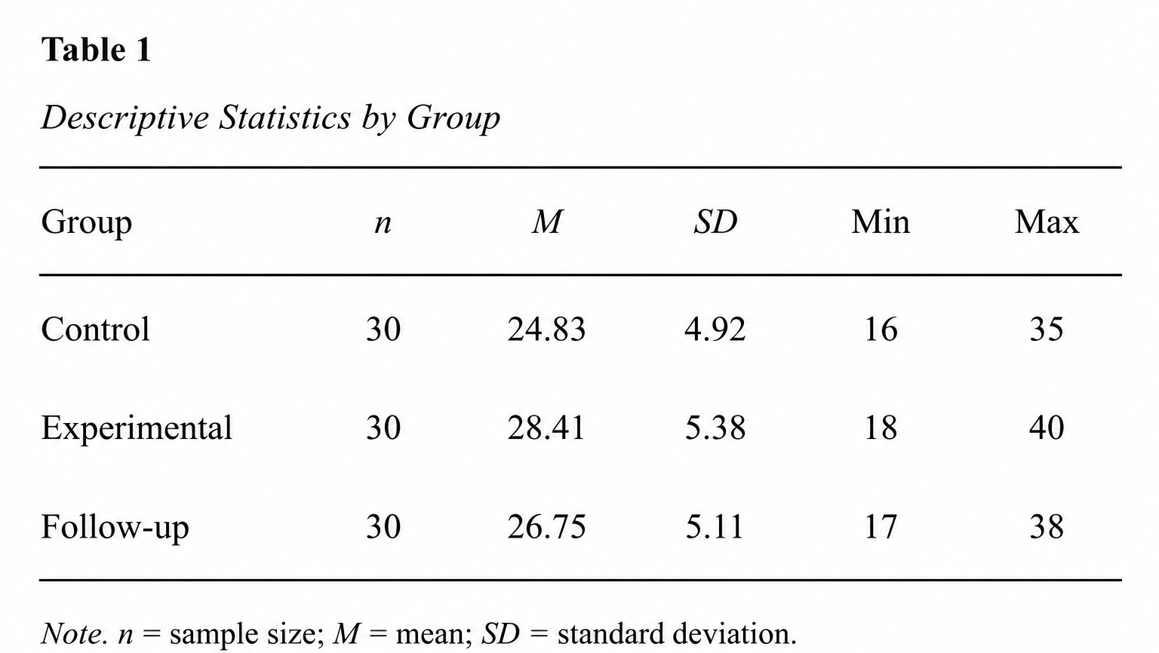
Tables

Slide 47
Tables
Table number is bold

Slide 48
Tables
Title on a separate line than the table number. Title should be italicized.

Slide 49
Tables
First column is left-justified

Slide 50
Tables
Remaining columns are centered

Slide 51
Tables
Horizontal lines only above and below the header and at the bottom of the table
No vertical lines

Slide 52
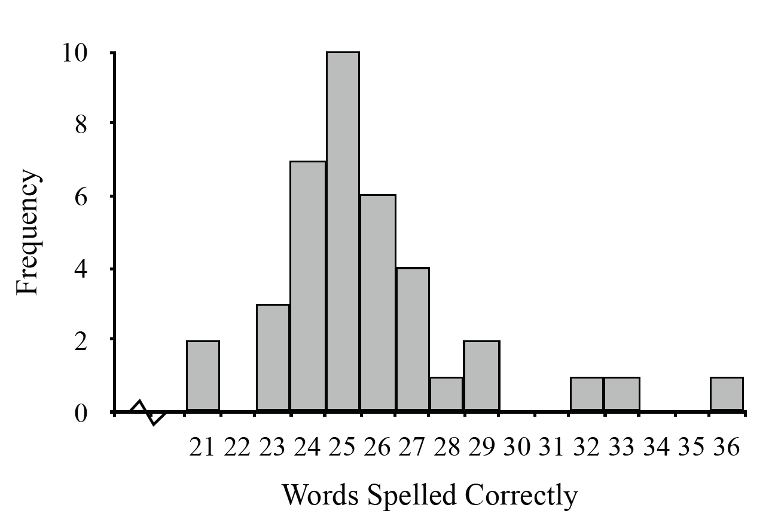
Figures
Histograms
IV: Interval or ratio
Bars touch

Slide 53
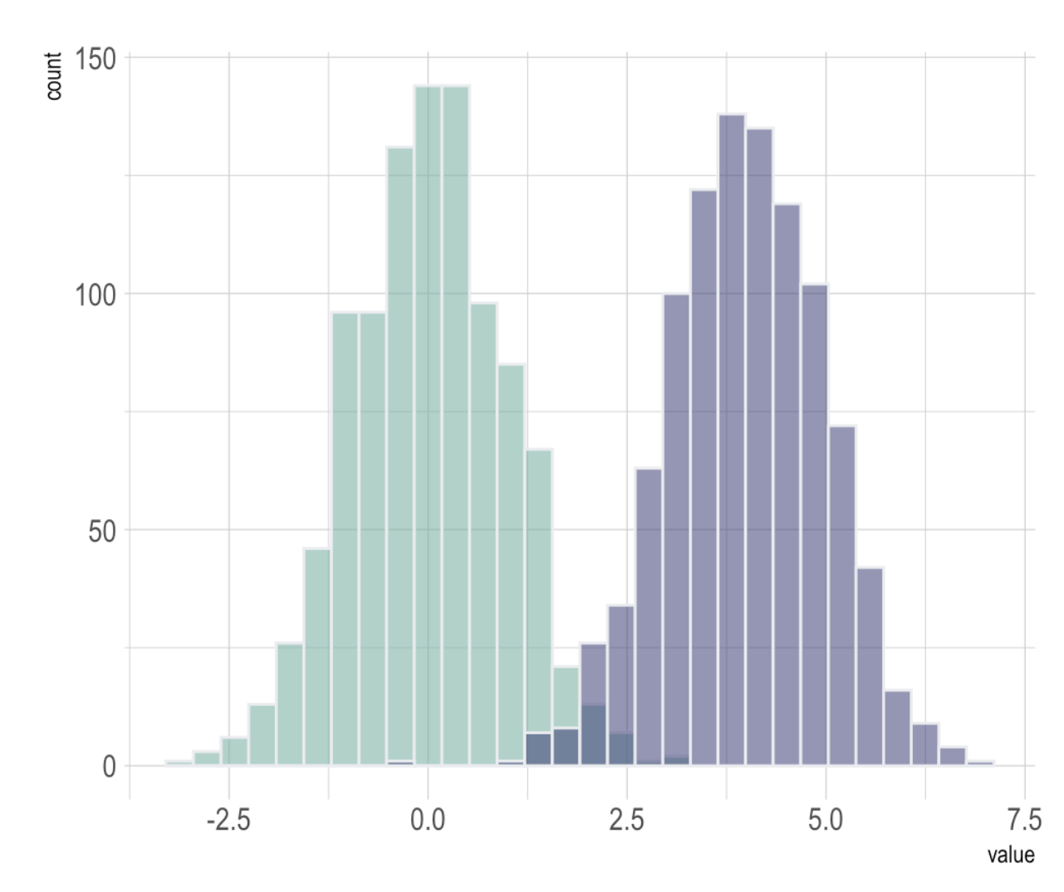
Figures
Histograms
IV: Interval or ratio
Bars touch
Second IV is nominal

Slide 54
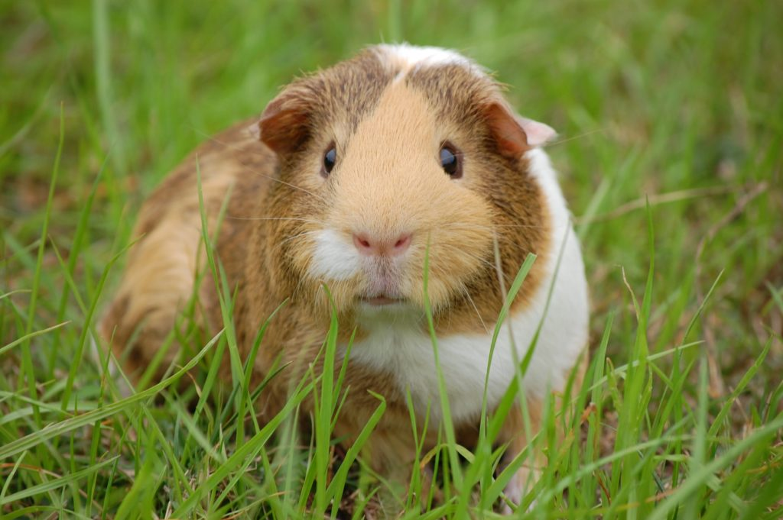
Does it change if the vitamin is delivered via orange juice (OJ) or ascorbic acid (AA)
What are the effects of different doses of Vitamin C on Guinea pig tooth length?

Slide 55
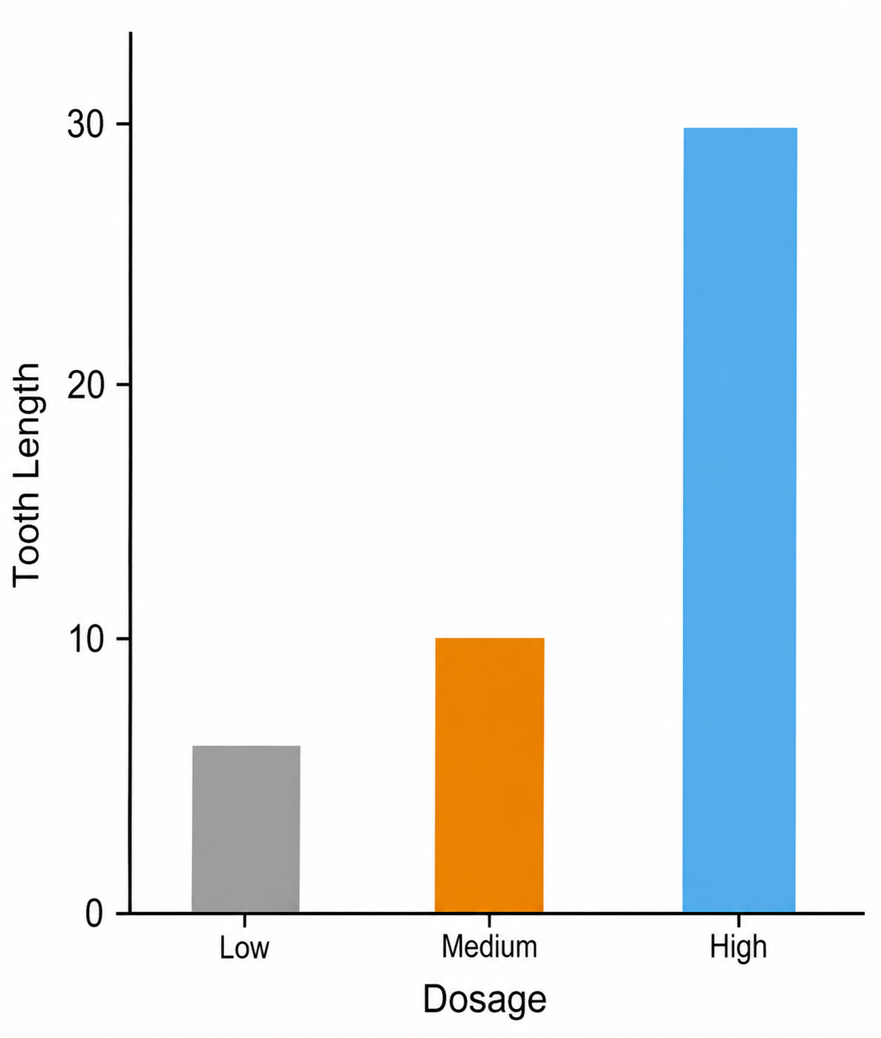
Figures

Slide 56
Figures
Bar Plot
IV: Nominal or ordinal
No measurable distance between categories
Spaces between categories

Slide 57
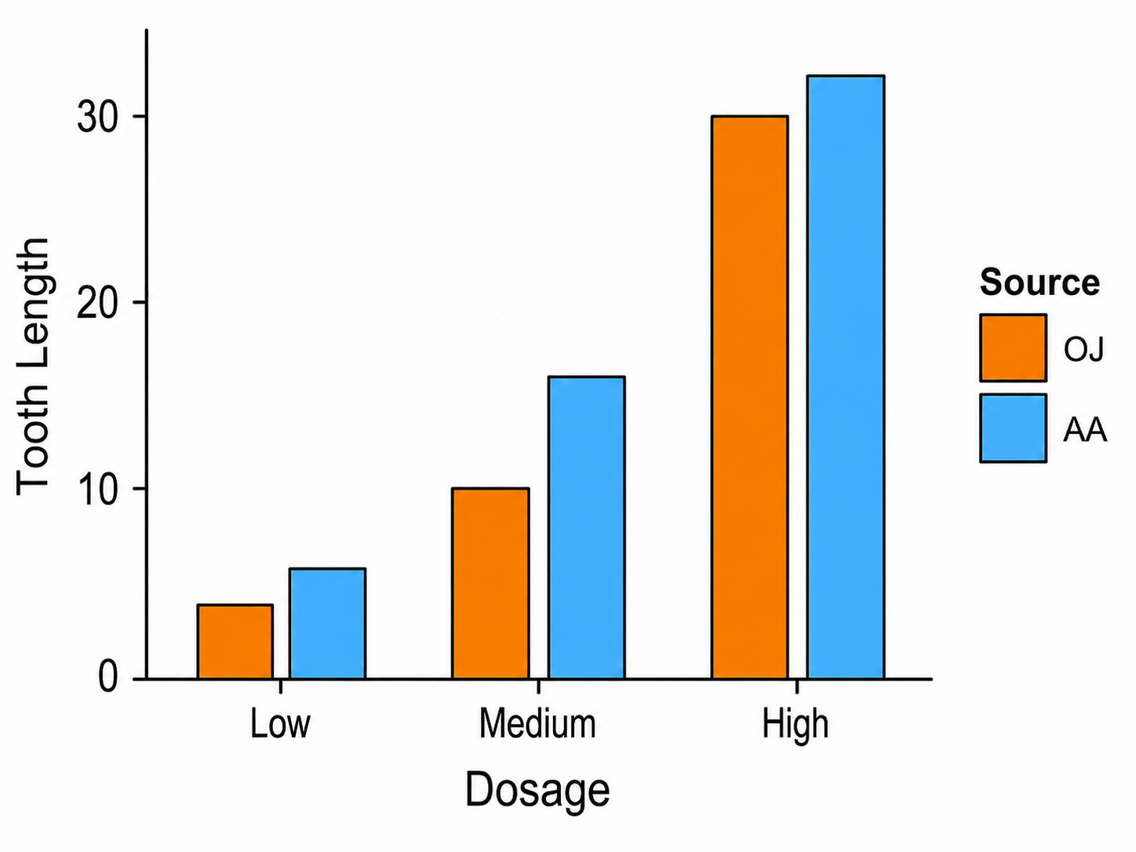
Figures
Bar Plot
IV: Nominal or ordinal
When two IVs
Second IV is nominal
Large gaps between the primary IV
Small gaps between the secondary IV

Slide 58
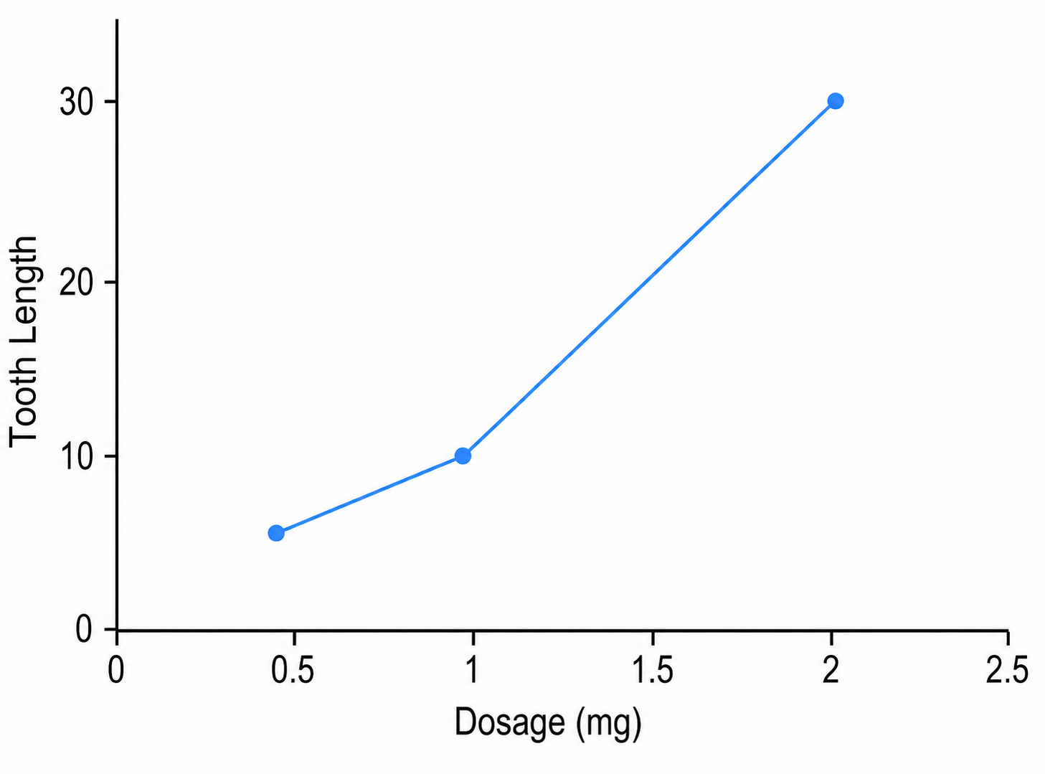
Figures
Line Plot
IV: Interval or ratio
Line connects the conditions

Slide 59
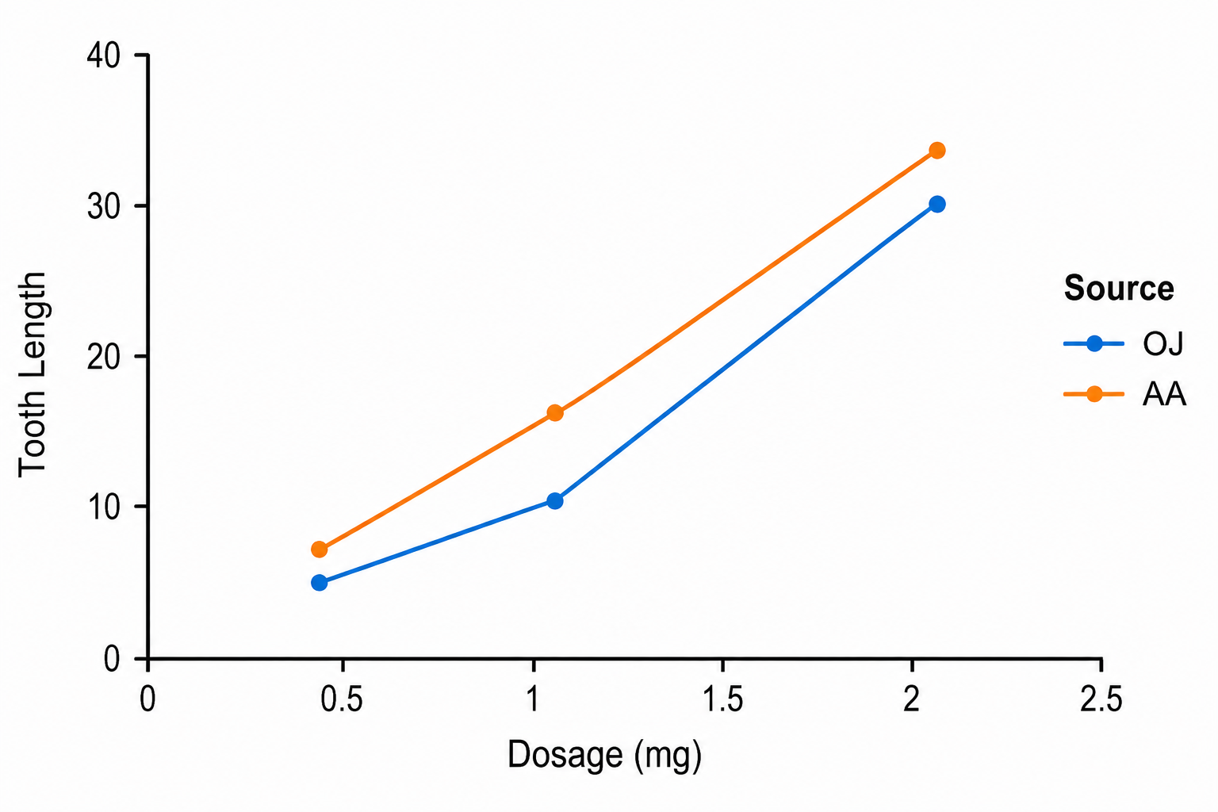
Figures
Line Plot
IV: Interval or ratio
Line connects the conditions
Second IV is nominal

Slide 60
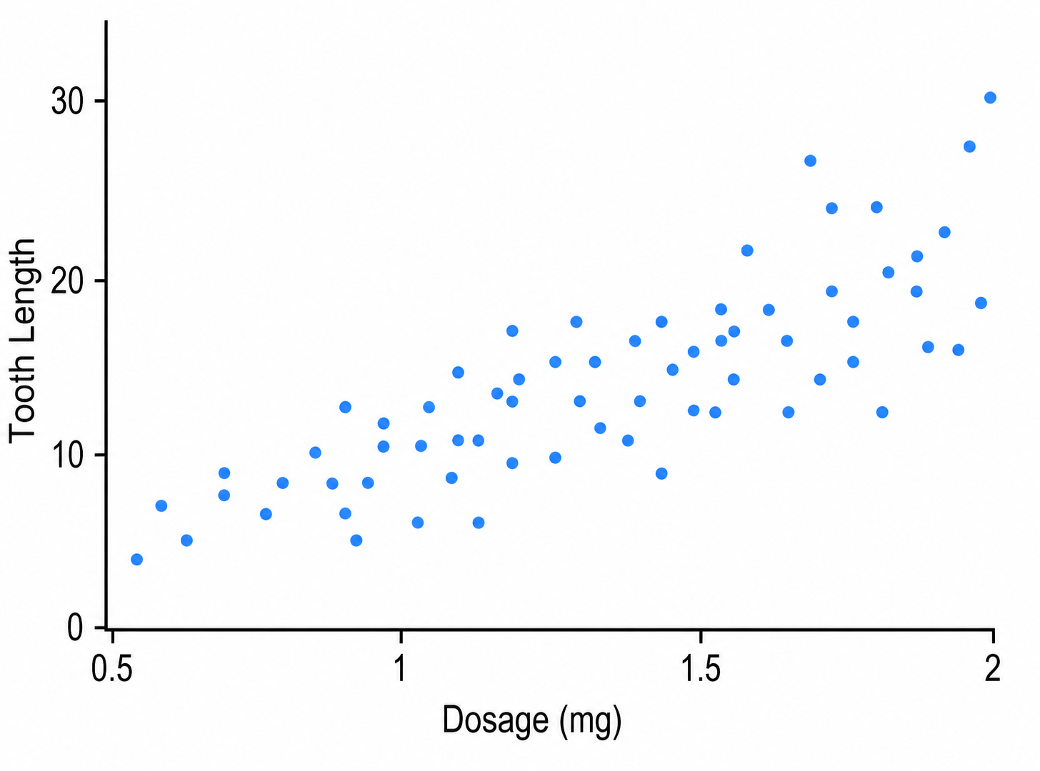
Figures
Scatterplot
IV: Interval or ratio
Bivariate data
i.e., two sets of data
Both sets of data are interval or ratio

Slide 61
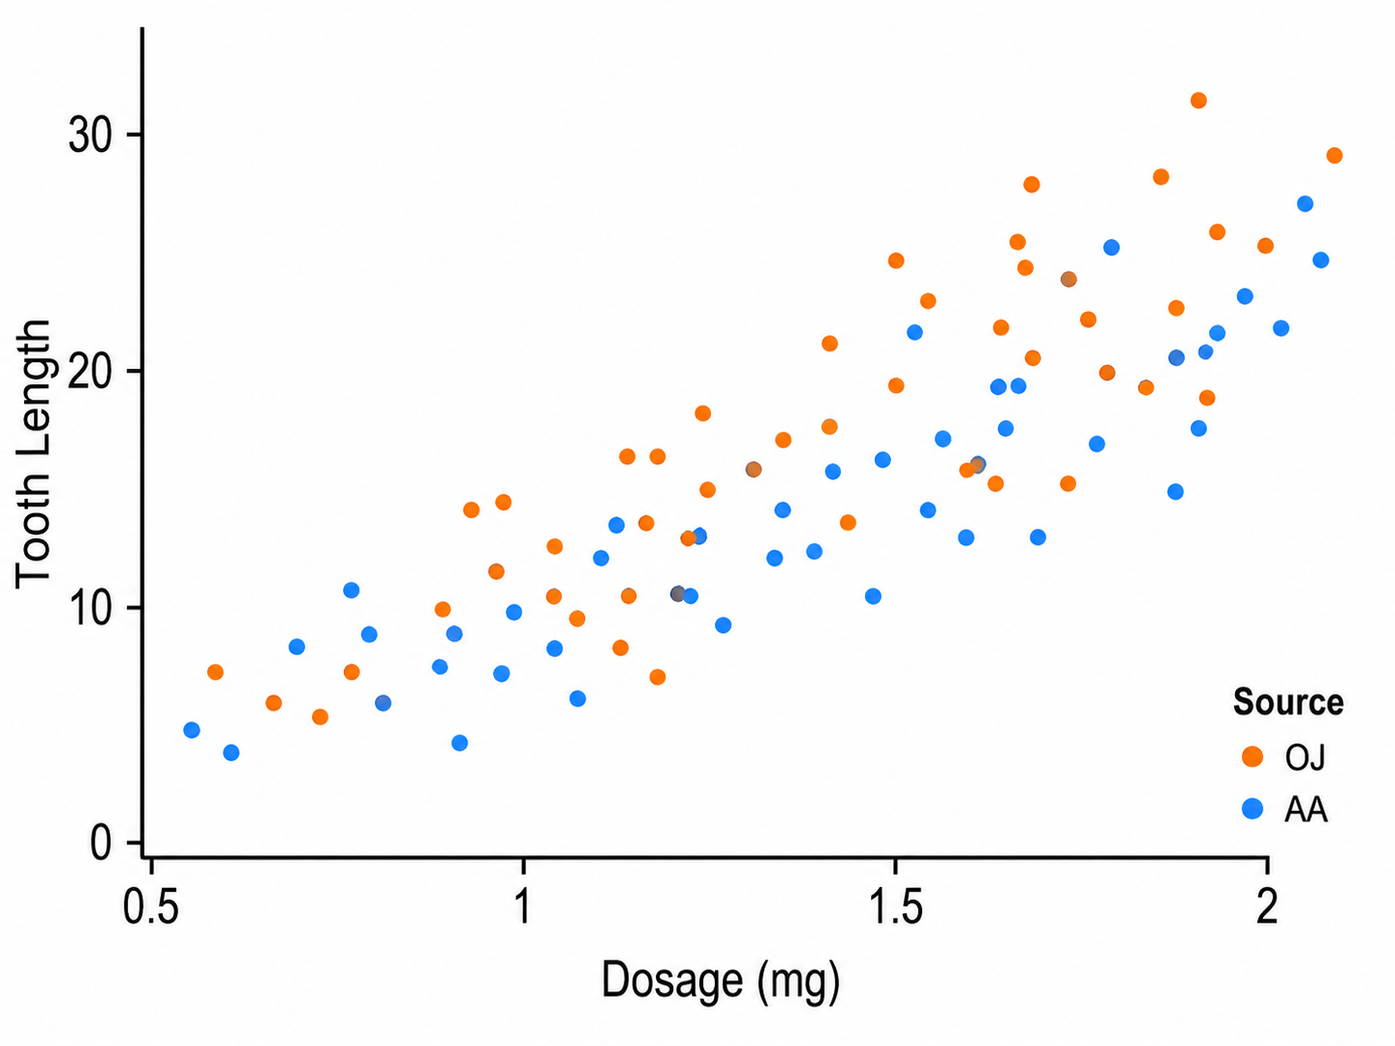
Figures
Scatterplot
IV: Interval or ratio
Bivariate data
i.e., two sets of data
Both sets of data are interval or ratio
Second IV is nominal

Slide 62
Does it change if the Vitamin is delivered via orange juice (OJ) or ascorbic acid (AA)
What are the effects of different doses of Vitamin C on Guinea pig tooth length?

Slide 63
One IV
Two IVs

Slide 64
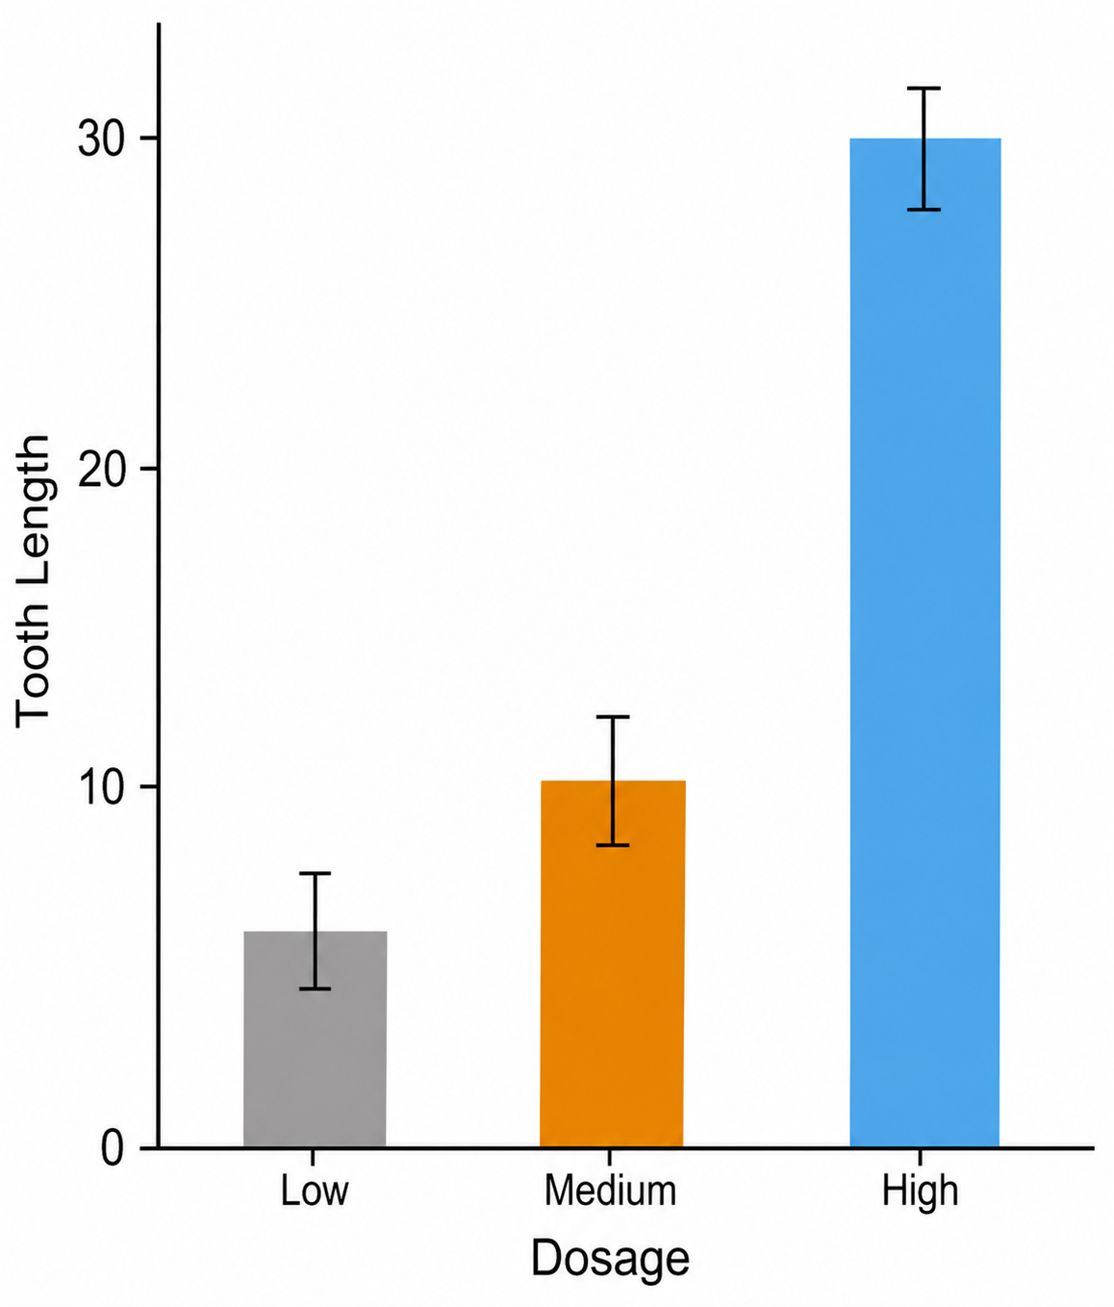
Error Bars
A note on error bars
They represent variability in our data
Variability will be covered in Unit 1.3.

Slide 65
Figures
Figure 1
Bar plot of Guinea Pig tooth length based on the dosage and source of Vitamin C

Slide 66
Figures
Figure number is bold
Figure 1
Bar plot of Guinea Pig tooth length based on the dosage and source of Vitamin C
Title on a separate line than the table number. Title should be italicized.

Slide 67
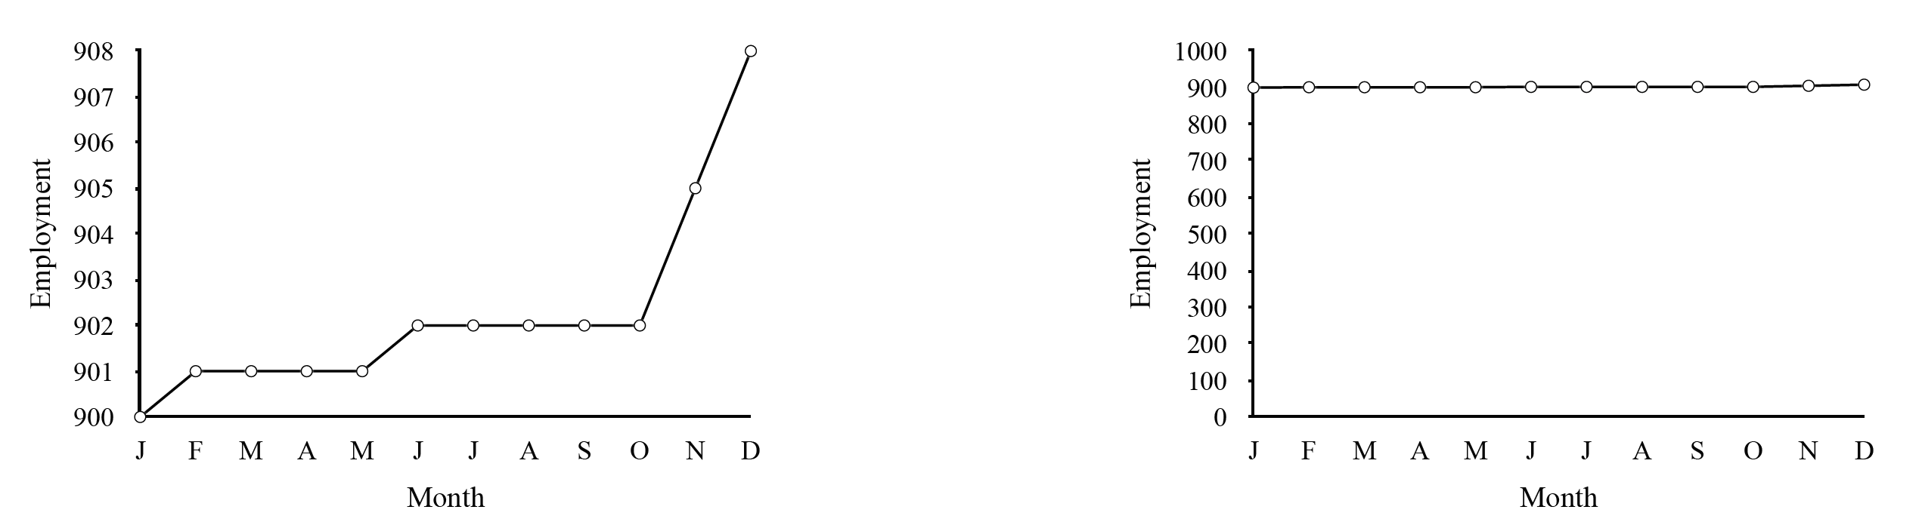
One Last Note
Lying with Graphs
You have a lot of control how to display your data
Do not abuse it!
Always be as transparent as possible!

Slide 68
Extra Resources

Slide 69
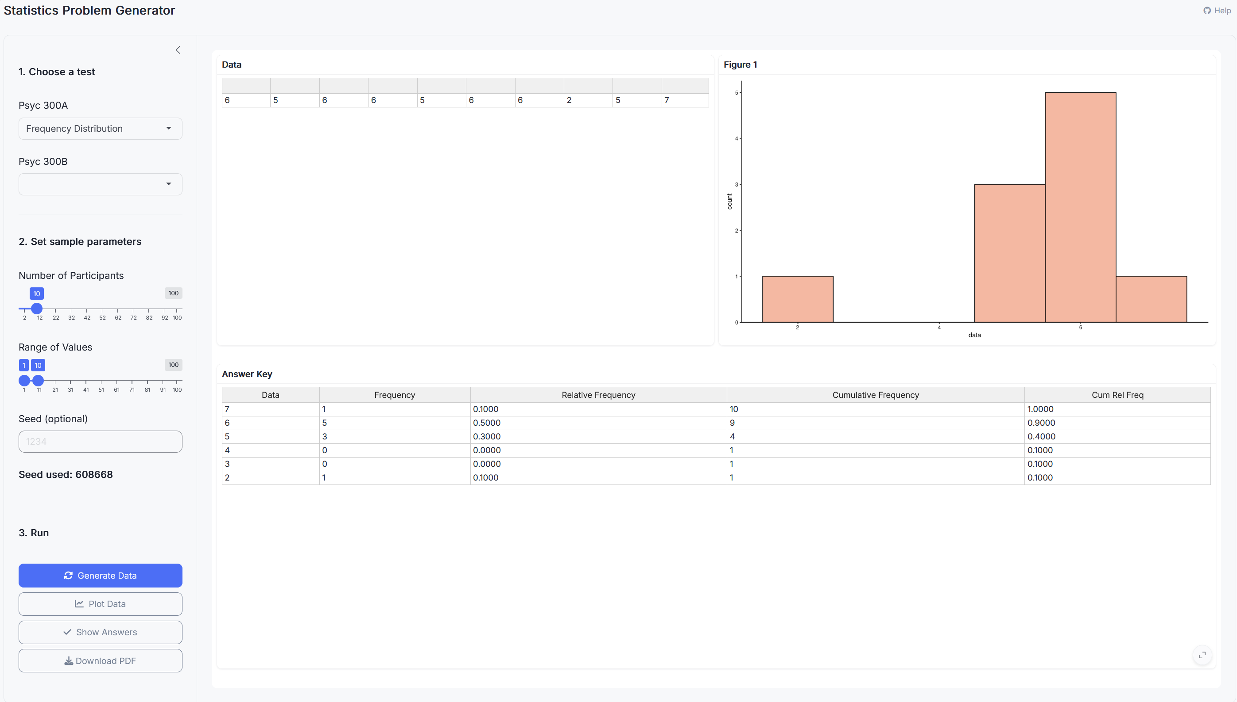
Stats Problem Generator
https://chadcwilliams.shinyapps.io/StatsProblemGenerator/

Slide 70
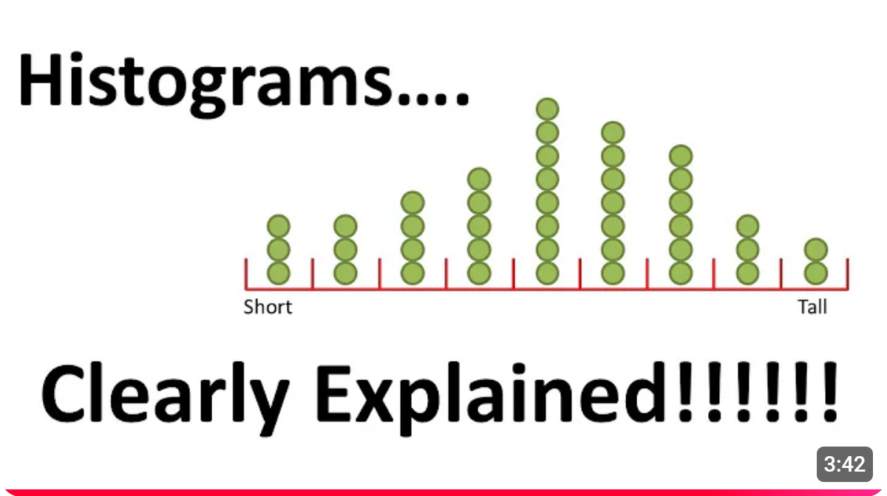
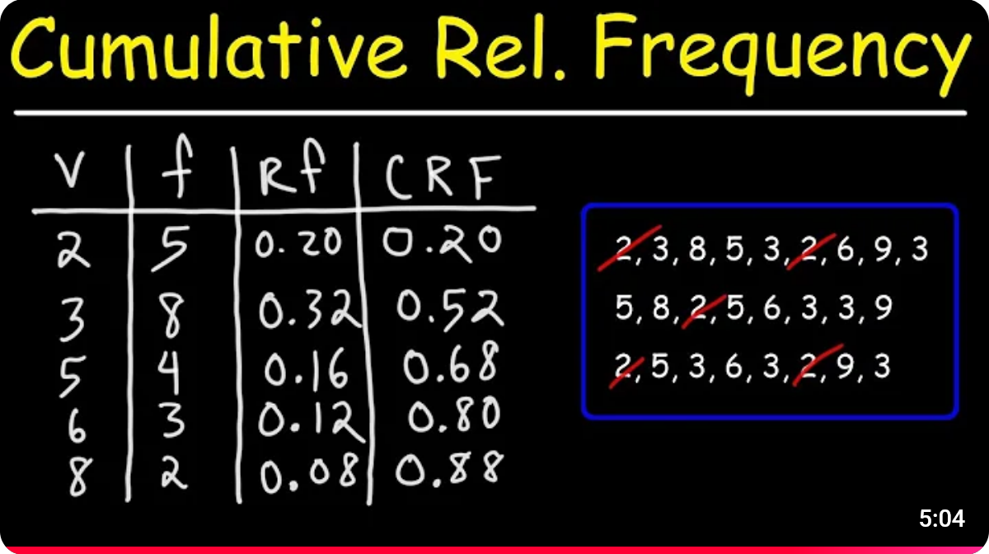
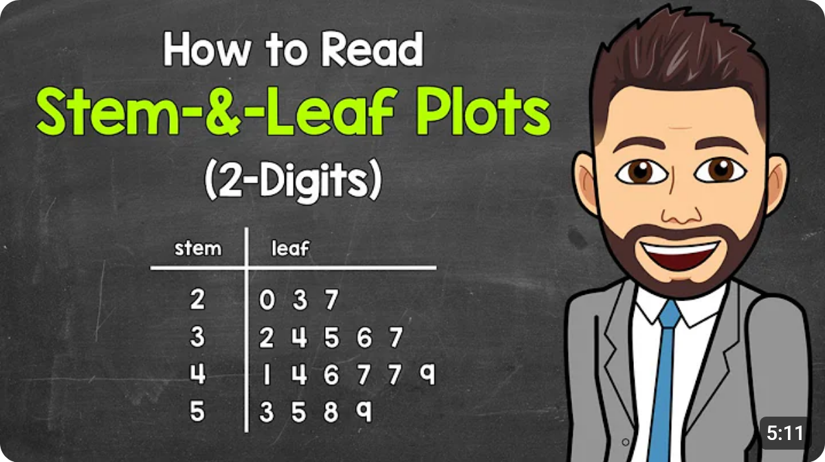
Extra Resources
Note: The frequency tables in this video go in ascending order, but we do it in descending order.

